Slide 1
ADVENTURE WORKS REPORT A Multinational Cycle Manufacturing Company Presented by P.Gangadhar
"Adventure Works: Sales, Profit, and Trends Analysis"

Slide 2
ABOUT THE COMPANY
Adventure works is looking forward to expand its market share over the world.
Coming off a successful fiscal year, Adventure Works Cycles is looking to broaden its market share by targeting their sales to their best customers, extending their product availability through an external Web site, and reducing their cost of sales through lower production costs. Adventure works wants detailed analysis of sales, products and all the other metrics required to make decisions on future plans. The analysis to be conducted are as follows:
1. Detailed Sale Analysis
2. Market Analysis - Analysis of Products and their popularity across various regions
3. All other metrics and insights that can help in expansion of business
4. Providing insights and strategic solutions.

Slide 3
DATASET DESCRIPTION
The dataset provided offers comprehensive insights into the sales performance and operations of Adventure Works Cycles, a multinational manufacturing company specializing in metal and composite bicycles.
It includes detailed information on sales transactions, customer demographics, product categories, regional sales performance, and manufacturing operations.
The dataset contained 7 Files:
Sales, Product Category, Product Subcategory,
Customer details, Territory details, and Date file
By analyzing this dataset, stakeholders can gain valuable insights into market trends, customer preferences, product performance, and operational efficiency, enabling informed decision-making and strategic planning to drive business growth and profitability.

Slide 4
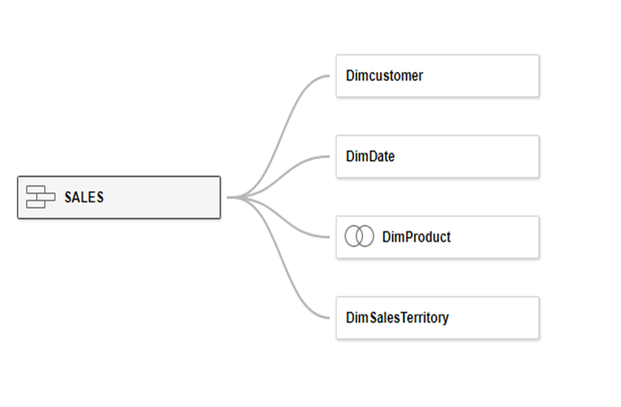
DATA MODELING
Out of the 7 datasets:
1. Union of both the sales files - new and old.
2. Date, territory and customer details were joined through respective keys
3. Inner join of Product, Product category and sub category was made then joined to main sales file
4. Master sales table was made
Additional columns added:
1. Total Sales = Unit Price Quantity sold
2. Production Cost = Unit price cost of product
3. Profit Sales - Production cost
4. Financial year, month, quarter
5. Calendar year, month, quarter from order date

Slide 5
INTRODUCTION
The Adventure Works Sales project involves analyzing data from the fictional Adventure Works company.
This company deals in manufacturing and selling Bicycles and Related Products.
The main focus of this project is to leverage the available sales data to gain insights into various business aspects, such as Sales Performance, Customer Demographics, and Product Profitability

Slide 6
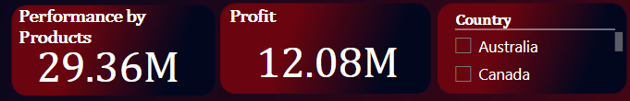
A) Performance Metrics :
Performance by Products:
Total revenue from products is 29.36M.
Profit:
Overall profit is 12.08M.
Country Filter:
Includes filters for Australia and Canada, enabling focused analysis for these regions.

Slide 7
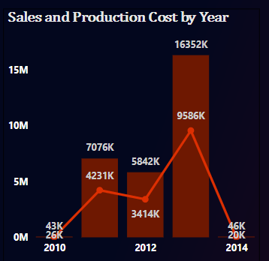
B) Sales and Production Cost by Year:
The bar chart visualizes sales and production costs from 2010 to 2014.
Key highlights:
2013 had the highest sales at 16,352K.
Production costs varied, peaking in 2012.

Slide 8
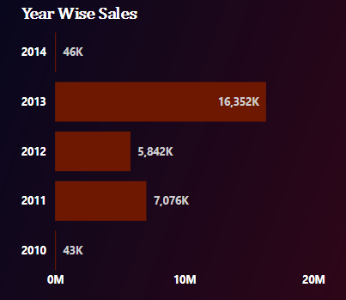
c) Year-Wise Sales:
A horizontal bar chart shows annual sales:
The highest sales occurred in 2013 (16,352K).
2014 and 2011 saw significantly lower sales.

Slide 9
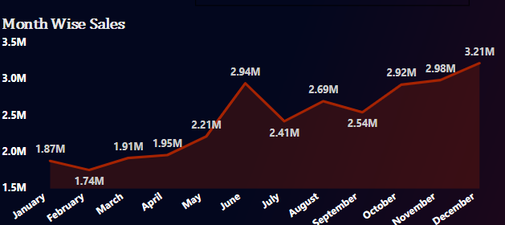
d) Month-Wise Sales:
A line chart plots monthly sales trends:
Sales peaked in December at 3.21M and hit a low in January at 1.74M.
There is a consistent rise in sales from mid-year onwards.

Slide 10
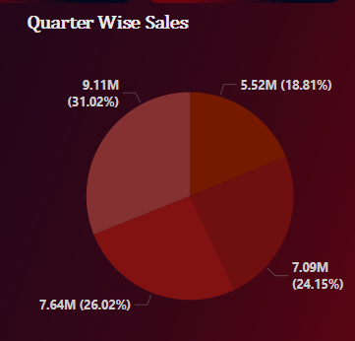
E) Quarter-Wise Sales Distribution:
A pie chart segments sales into four quarters:
Q4 contributes the largest share (31.02%).
The smallest share comes from Q1 (18.81%).

Slide 11
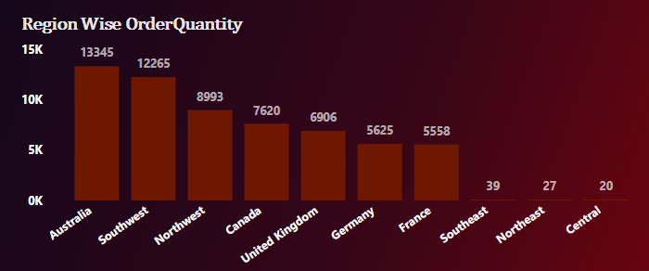
F) Region-Wise Order Quantity:
A bar chart illustrates order quantities across regions:
Australia leads with 13,345 orders.
The lowest order volumes are in Northeast and Central regions.

Slide 12
2. Insights:
Seasonal Trends: Sales peak in Q4, indicating strong seasonal demand likely tied to year-end events or promotions.
Regional Strengths: Australia and Southwest regions are top performers, contributing significantly to total order quantity.
Annual Performance: 2013 stands out as the best year for sales, suggesting potential reasons like market expansion or new product launches.
Profit Margin: While the dashboard shows profit as 12.08M, the correlation between production costs and sales could be analyzed further to identify cost optimization opportunities.

Slide 13
3. Recommendations for Decision-Makers:
Focus on High-Performing Regions: Enhance marketing efforts in Australia and Southwest regions to maintain their performance.
Boost Q1 Sales: Implement strategies like promotions or product launches to improve sales in the first quarter.
Production Costs: Investigate high production costs in 2012 and 2013 to ensure profitability remains stable.

Slide 14
OBJECTIVE
The primary objective is to analyze historical sales data to generate actionable insights for future sales predictions. This includes optimizing marketing strategies, improving decision-making, and understanding customer behavior. Tools like Microsoft Power BI, Tableau, SQL, and Excel were used to create visualizations and analyze data.

Slide 15
PAST HISTORY
Adventure Works has accumulated sales data from 2015 to 2017, giving us a comprehensive view of their business trends over the years. The data contains detailed information on various aspects, such as:
Sales Data : Including orders, invoices, and salesperson territories
Product Data : Covering product categories, subcategories, and individual product details.
Customer Data : Including customer demographics and purchasing patterns.
Territory Data : Detailing sales performance across different regions.
By examining this dataset, the aim is to uncover patterns that lead to successful sales strategies. The project provides a foundation for enhancing the company’s operations, customer satisfaction, and overall profitability.

Slide 16
SALES PERFORMANCE ANALYSIS
Revenue Trends: By analyzing revenue trends over different periods, the project uncovers peak sales seasons and helps identify slow-performing months. This allows for better inventory management and sales forecasting.
Product Performance: The analysis helps in understanding which products are top-sellers and which are lagging. This information is crucial for product lineup adjustments and marketing focus.
Sales Channels: Evaluation of different sales channels, such as online stores versus physical retail locations, to understand where the majority of the revenue is coming from. This analysis aids in channel optimization.

Slide 17
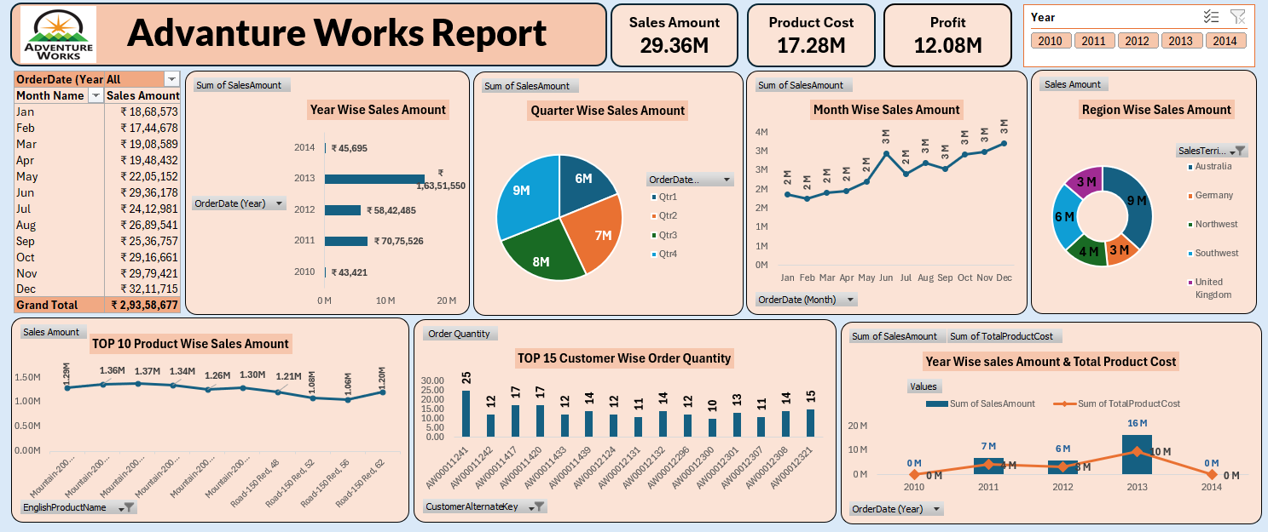
EXCEL DASHBOARD

Slide 18
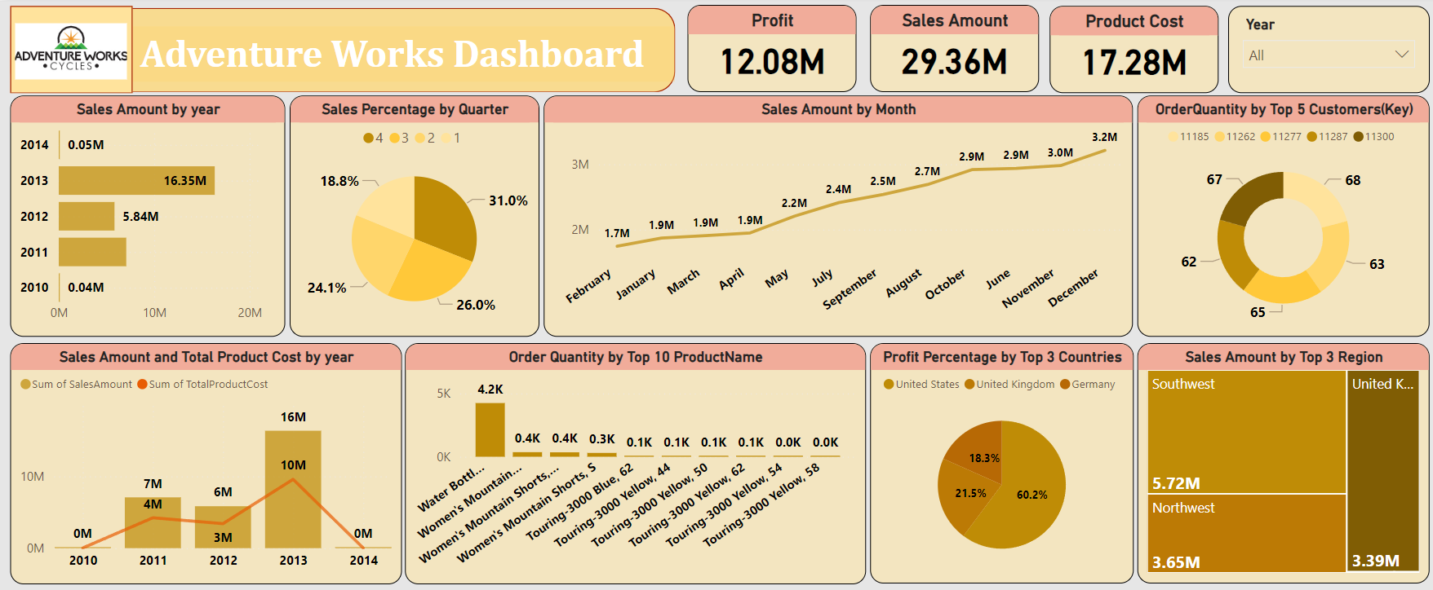
POWER BI DASHBOARD

Slide 19
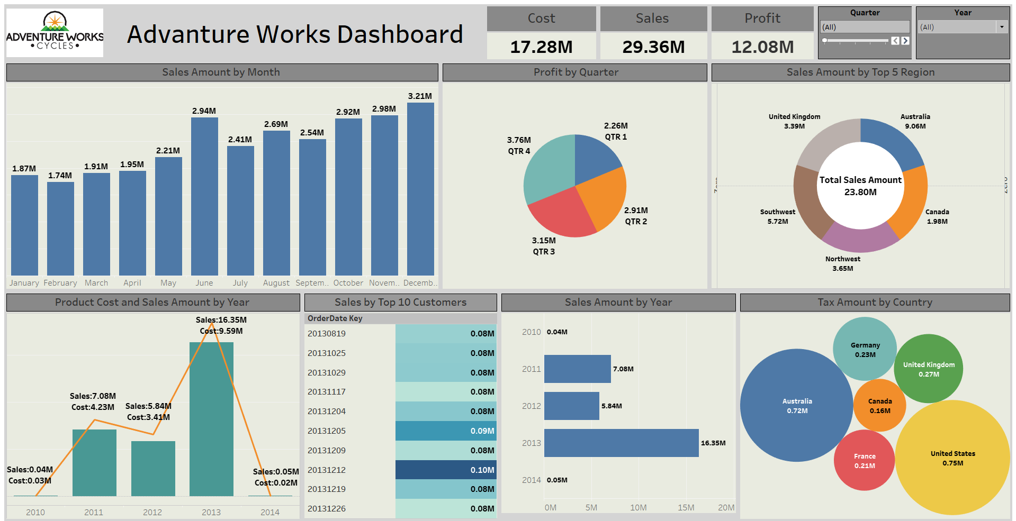
TABLEAU DASHBOARD

Slide 20
FUTURE RECOMMENDATIONS
Inventory Management: Implementing Just-In-Time (JIT) inventory systems to reduce carrying costs and improve cash flow.
Marketing Efficiency: Utilizing the insights gained for hyper-targeted marketing campaigns that are data-driven and results-oriented.
New Market Entry: Using the geographical analysis to identify potential new markets for expansion based on current performance trends.

Slide 21
CONCLUSION
This project helped us to dive deeper into exploratory data analysis and the art of deriving insights. The analysis of Adventure Works Cycles' sales data has revealed key areas of opportunity for the company to capitalize on. By targeting its best customers, expanding its online presence, and optimizing production processes, Adventure Works Cycles can enhance its market share and profitability. With a cle nderstanding on market trends and customer preferences, the company can make informed decisions that drive growth and ensure long-term success in an increasingly competitive market landscape.

Slide 22
FOLLOW FOR MORE
LinkedIn : www.linkedin.com/in/gangadharpappaka
Github : https://github.com/gangadharpappaka9
Personal Portfolio :https://gangadharpappaka9.github.io/gangadharpappaka

Slide 23


